Slide 1
U : 12 P.92-93

Slide 2
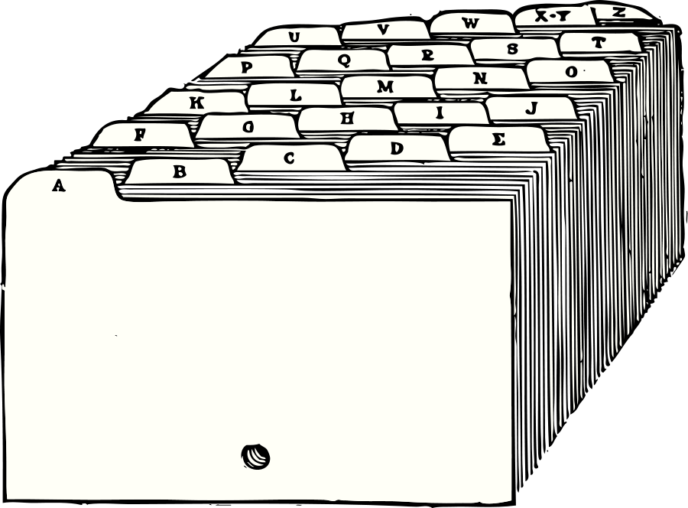
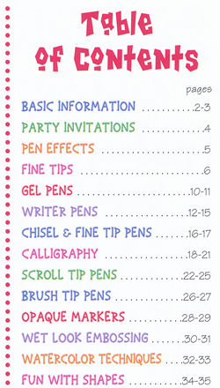
U : 12 P.92-93
content
( N. )
The content of the book is described in
the beginning of the book.

Slide 3
U : 12 P.92-93
suitable
( adj. )
You are suitable for the job.

Slide 4
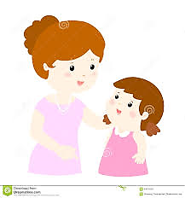
U : 12 P.92-93
emphasise
( v. )
emphasised - emphasised

Slide 5
U : 12 P.92-93
emphasise
( v. )
He emphasized the importance of peace.

Slide 6
U : 12 P.92-93
narration
( N. )
The narration of the folk tale made it
more interesting.

Slide 7
U : 12 P.92-93
reinforce
( V. )
reinforced - reinforced

Slide 8
U : 12 P.92-93
reinforce
( V. )
You need to use pictures to reinforce
your message.

Slide 9
U : 12 P.92-93
reinforce (V.) reinforced
narration (N.)
emphasise (V.) emphasized
content (N.)
suitable (adj.)

Slide 10
U : 12 P.92-93

Slide 11
U : 12 P.92-93

Slide 12
U : 12 P.92-93

